Slide 1
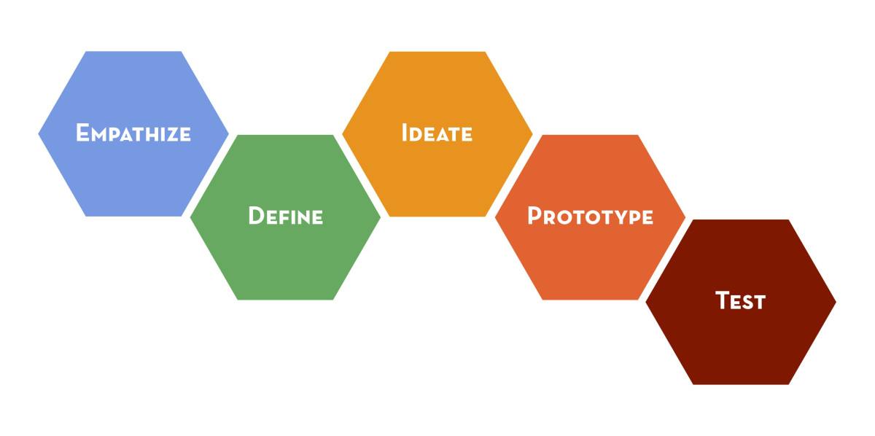
Design Thinking

Slide 2
I.Design Thinking: Definition and History
Design thinking gives us a process to come up with solutions to big and small problems…it helps us gain back our creative confidence.
IDEO, http://www.creativeconfidence.com/tools

Slide 3
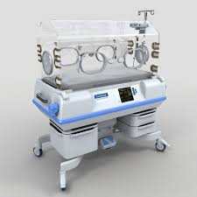
II.Success Stories: Embrace
http://embraceglobal.org/embrace-warmer
Notes:
http://www.ted.com/talks/jane_chen_a_warm_embrace_that_saves_lives?language=en

Slide 4
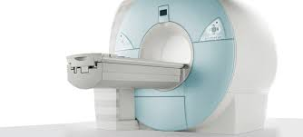
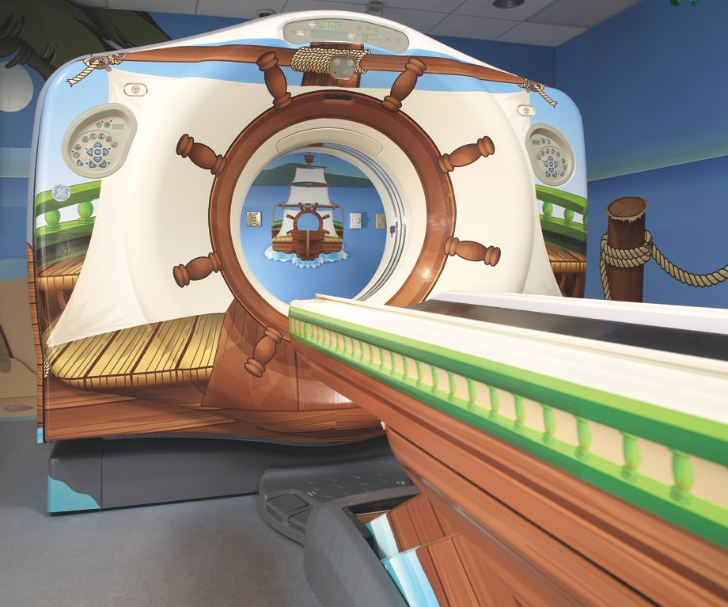
II.Success Stories: MRI Machines
https://www.youtube.com/watch?v=hnSPmcZjEqs
http://www.ted.com/talks/david_kelley_how_to_build_your_creative_confidence?language=en, 7:35
Notes:
http://www.ted.com/talks/david_kelley_how_to_build_your_creative_confidence?language=en, 7:35
Doug Dietz, https://www.youtube.com/watch?v=hnSPmcZjEqs
Doug Dietz lecture, https://www.youtube.com/watch?v=jajduxPD6H4

Slide 5
II.Success Stories: Collaboration
Collaboration, Open IDEO
https://openideo.com/challenge/zero-to-five/research/it-takes-a-village-to-raise-a-child
https://openideo.com/challenge
http://www.creativeconfidence.com/tools
http://blog.creativeconfidence.com/
Go to methods and resources, http://www.extremebydesignmovie.com/#

Slide 6
II.Success Stories:With Kids
Example
https://www.youtube.com/watch?v=nyt4YvXRRGA
For educators, http://www.designthinkingforeducators.com/
Mt. Vernon Institute, http://deepdesignthinking.com/

Slide 7
II.Success Stories:Videos
http://www.extremebydesignmovie.com/
http://designthinkingmovie.com/#screening

Slide 8
III.The Process

Slide 9
III.The Process
We will now learn about the process by doing.
A.We will do the wallet exercise from Stanford D’s School, https://dschool.stanford.edu/groups/designresources/wiki/4dbb2/The_Wallet_Project.html
B.Then we will do our own design challenge together.
C.I will later give you a list of all resources for Design thinking.

